Slide 1
Capstone Final Project Summary
Jun Wu
2019.01.23

Slide 2
Introduction
Problem Description
  A meat supplier contractor is planning to expand their service in one of the boroughs of Toronto(Scarborough). The plan is to provide fresh and high quality meat to the restaurants in this borough. Our mission is to find a good business location for this contractor

Slide 3
Data for solving the problem
  Basically, we need geo-locational information about that specific borough. We will also need data about different venues in different neighborhoods of Scarborough. We will use "Foursquare" locational information to acquire these info. Especially, we need valuable information, such as the category of that venue, and whether the venue is a popular one in its category.

Slide 4
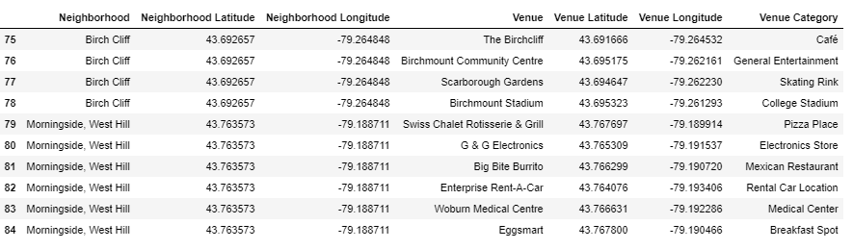
A typical request from Foursquare will provide us with the following information:

Slide 5
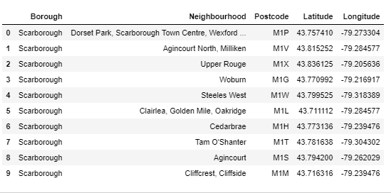
Main Part
Part 1: Identifying Postal Codes (and then Neighborhoods ) in "Scarborough"

Slide 6
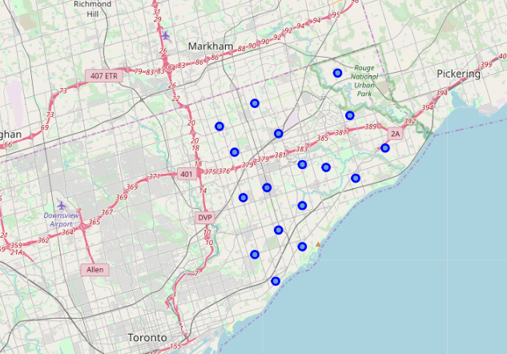
Part 1: Identify the postal codes in "Scarborough"

Slide 7
Part 2: Retrieving Locational Data for each venue in each Neighborhood from Foursquare
With the list of neighborhoods, we connect to the Foursquare API to retrieve information about venues inside each and every neighborhood. For each neighborhood, we have chosen the radius to be 1000 meter.

Slide 8
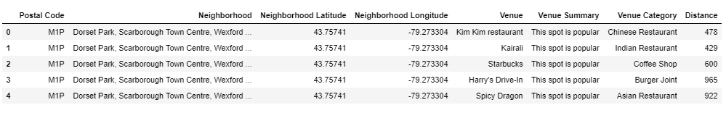
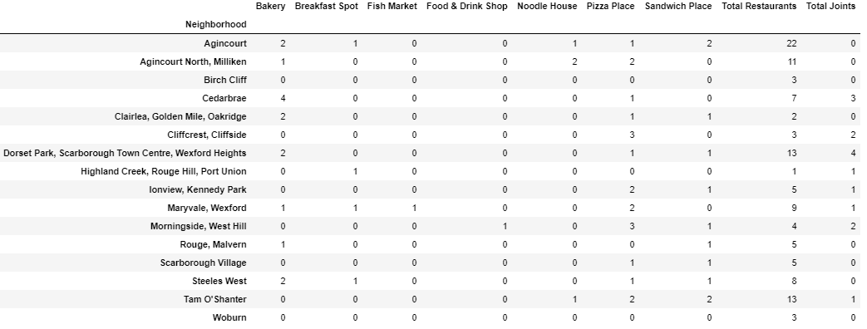
Part 3: Processing and Creating a DataFrome for All the Venues inside the Scarborough

Slide 9
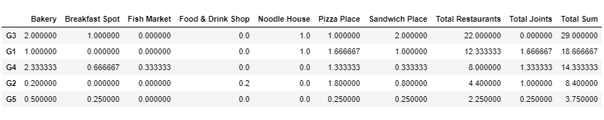
Part 4: Applying one of Machine Learning Techniques (K-Means Clustering)

Slide 10
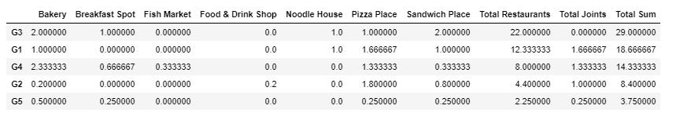
Final Results:
We focus on the centers of clusters and compare them for their "Total Restaurants" and their "Total Joints". The group which its center has the highest "Total Sum" will be our best recommendation to the contractor. {Note: Total Sum = Total Restaurants + Total Joints + Other Venues.}
Best Group is: G3
second best group is: G1
third best group is G4.

Slide 11
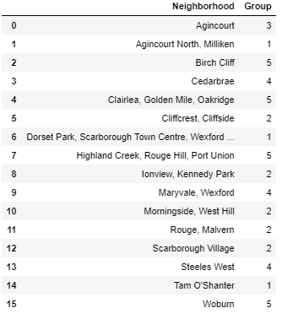
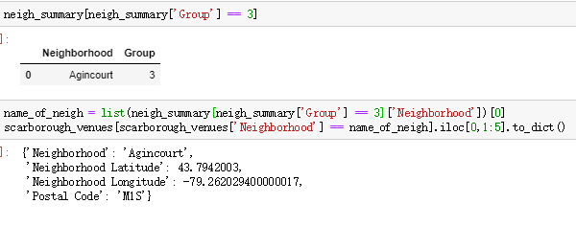
Neighborhood summary with result:

Slide 12
THANK YOU

